Slide 1
Trees

Slide 2
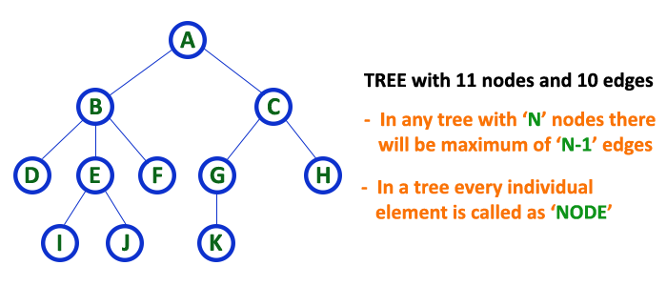
Tree Definition
Tree is a non-linear data structure which organizes data in hierarchical structure and this is a recursive definition.

Slide 3

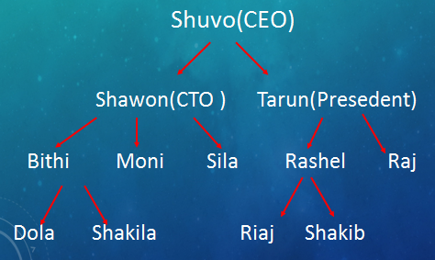
Logic of Tree

Slide 4

Logic of Tree

Slide 5
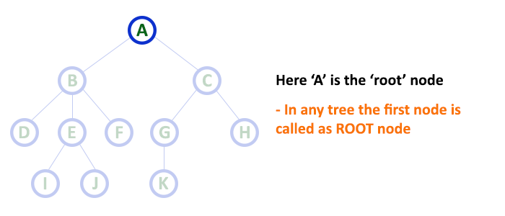
Tree terminology
1.Root:
The first node is called as Root Node.
Every tree must have root node, there must be only one root node.
Root node doesn't have any parent.

Slide 6
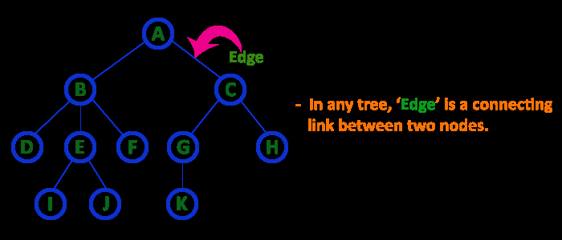
2. Edge
In a tree data structure, the connecting link between any two nodes is called as EDGE. In a tree with 'N' number of nodes there will be a maximum of 'N-1' number of edges.

Slide 7
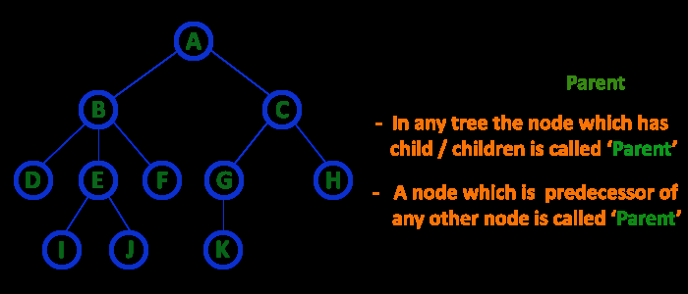
3. Parent
In a tree data structure, the node which is predecessor of any node is called as PARENT NODE. In simple words, the node which has branch from it to any other node is called as parent node. Parent node can also be defined as "The node which has child / children".

Slide 8
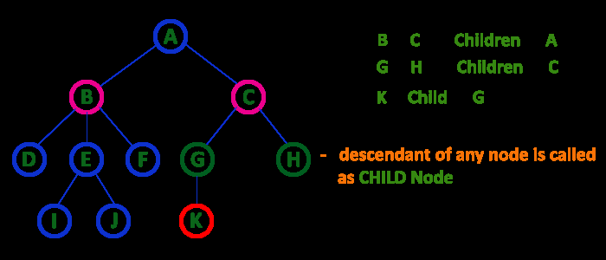
4. Child
The node which has a link from its parent node is called as child node.
In a tree, any parent node can have any number of child nodes.
In a tree, all the nodes except root are child nodes.

Slide 9
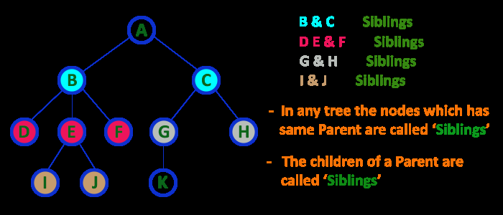
5. Siblings
The nodes with same parent are called as Sibling nodes.

Slide 10
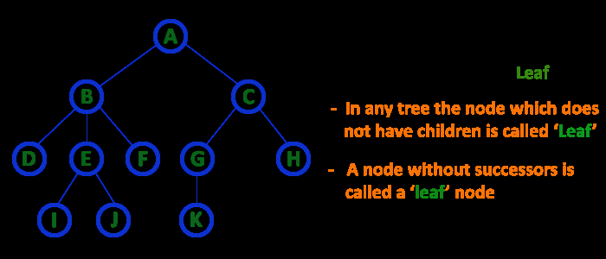
6. Leaf Node
The node which does not have a child is called as LEAF Node.
The leaf nodes are also called as External Nodes or 'Terminal' node.

Slide 11
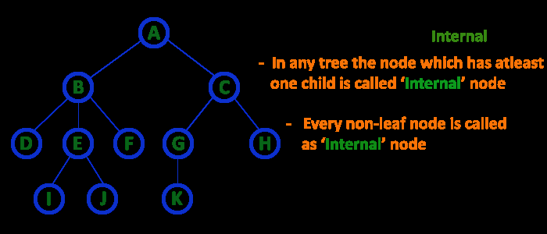
7. Internal Nodes
An internal node is a node with atleast one child.
Nodes other than leaf nodes are called as Internal Nodes.
The root node is also said to be Internal Node if the tree has more than one node. Internal nodes are also called as 'Non-Terminal' nodes.

Slide 12
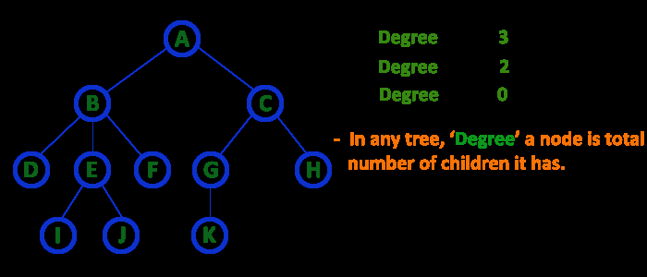
8. Degree
In a tree data structure, the total number of children of a node is called as DEGREE of that Node.

Slide 13
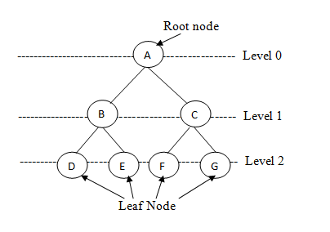
9. Level
In a tree data structure, the root node is said to be at Level 0 and the children of root node are at Level 1 and the children of the nodes which are at Level 1 will be at Level 2 and so on...
In a tree each step from top to bottom is called as a Level and the Level count starts with '0' and incremented by one at each level (Step).

Slide 14
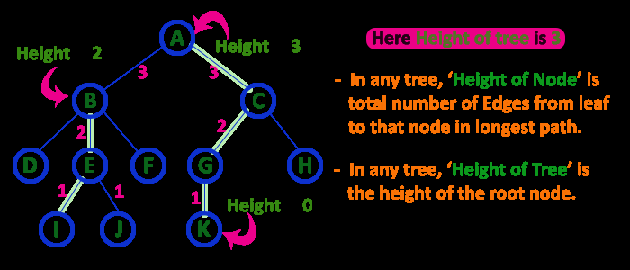
10. Height
The total number of egdes from leaf node to a particular node in the longest path is called as HEIGHT of that Node.
In a tree, height of the root node is said to be height of the tree.

Slide 15
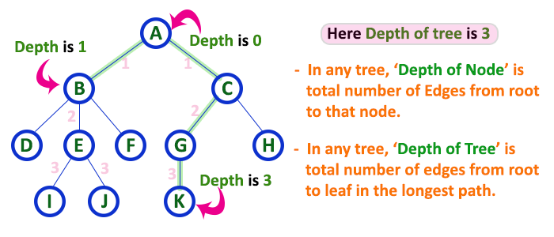
11. Depth
In a tree data structure, the total number of egdes from root node to a particular node is called as DEPTH of that Node.

Slide 16
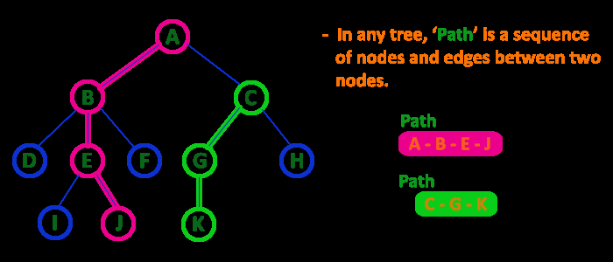
12. Path
In a tree data structure, the sequence of Nodes and Edges from one node to another node is called as PATH between that two Nodes.
Length of a Path is total number of nodes in that path. In below example the path A - B - E - J has length 4.

Slide 17
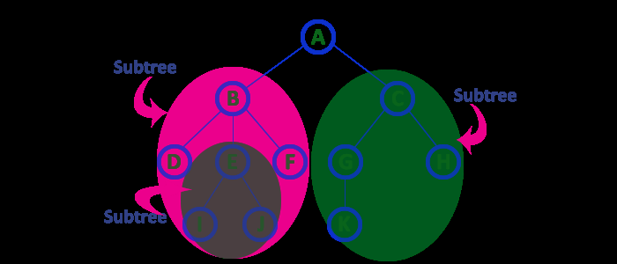
13. Sub Tree
Every child node will form a subtree on its parent node.

Slide 18
Type of Trees
General tree
Binary tree
Binary Search Tree

Slide 19
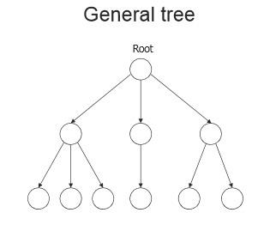
General Tree
A general tree is a data structure in that each node can have infinite number of children .
In general tree, root has in-degree 0 and maximum out-degree n.
Height of a general tree is the length of longest path from root to the leaf of tree. Height(T) = {max(height(child1) , height(child2) , … height(child-n) ) +1}

Slide 20
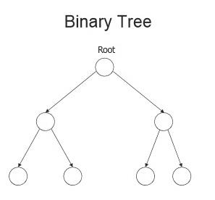
Binary tree
A Binary tree is a data structure in that each node has at most two nodes left and right
In binary tree, root has in-degree 0 and maximum out-degree 2.
In binary tree, each node have in-degree one and maximum out-degree 2.
Height of a binary tree is : Height(T) = { max (Height(Left Child) , Height(Right Child) + 1}

Slide 21
Representation of Binary Tree
Array Representation
Linked List Representation.

Slide 22
Representation of Binary Tree
Struct node { int data; struct node * left, right; };

Slide 23
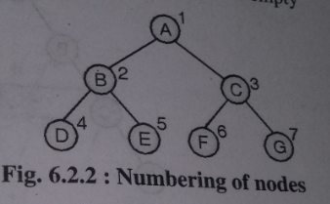

Array Representation
To represent a tree in one dimensional array nodes are marked sequentially from left to right start with root node.
First array location can be used to store no of nodes in a tree.

Slide 24
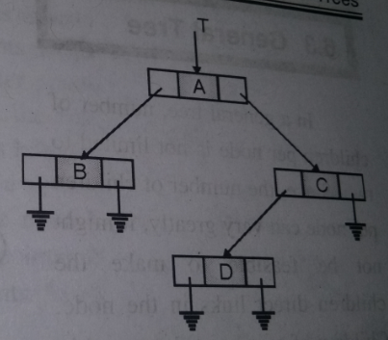
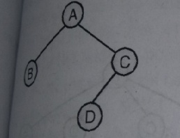
Linked Representation
This type of representation is more efficient as compared to array.
Left and right are pointer type fields left holds address of left child and right holds address of right child.
Struct node { int data; struct node * left,*right; };

Slide 25
Binary Tree Types
Extended Binary Tree
Complete Binary Tree
Full Binary Tree
Skewed Binary Tree
Strictly Binary Tree
Expression Binary tree

Slide 26
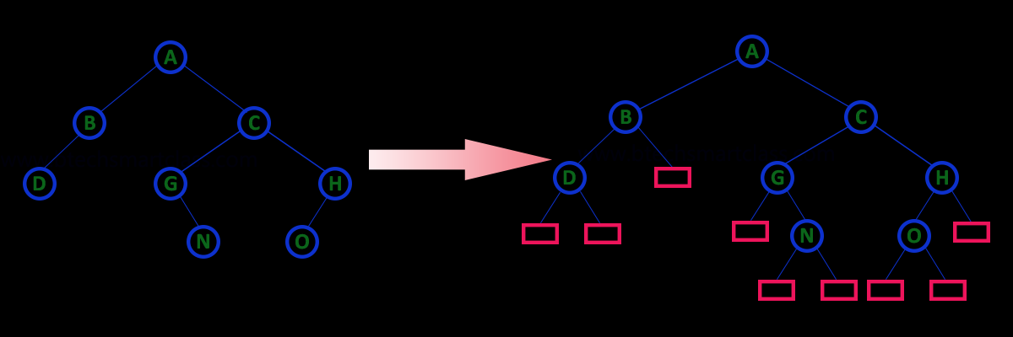
Extended Binary Tree
An extended binary tree is a transformation of any binary tree into a complete binary tree. This transformation consists of replacing every null subtree of the original tree with “special nodes” or “failure nodes”. The nodes from the original tree are then internal nodes, while the “special nodes” are external nodes.

Slide 27
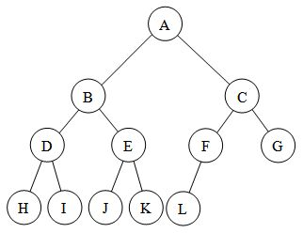
Complete Binary Tree
A complete binary tree is a tree in which
All leaf nodes are at n or n-1 level
Levels are filled from left to right

Slide 28
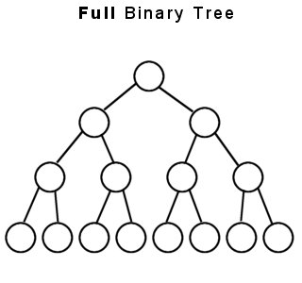
Full Binary Tree
A full binary tree (sometimes proper binary tree or 2-tree) is a tree in which every node other than the leaves has two children or no childeren. Every level is completely filled up.
No of nodes= 2^{h+1} -1

Slide 29
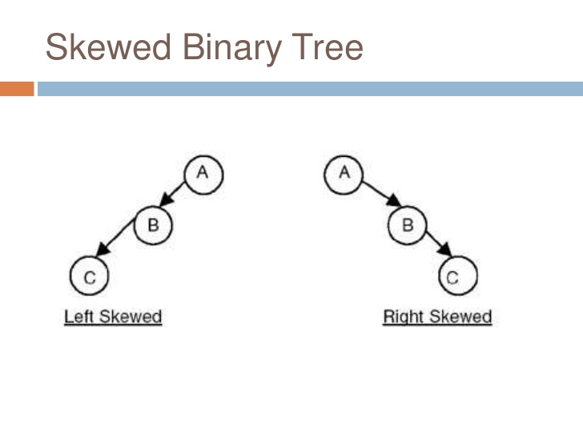
Skewed Binary Tree
A binary tree is said to be Skewed Binary Tree if every node in the tree contains either only left or only right sub tree. If the node contains only left sub tree then it is called left-skewed binary tree and if the tree contains only right sub tree then it is called right-skewed binary tree.

Slide 30
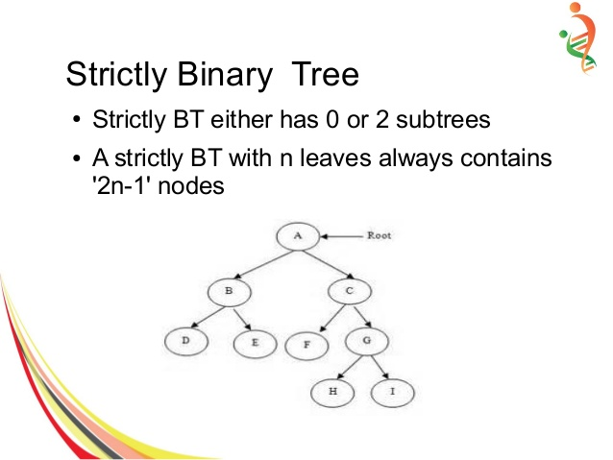
Strictly Binary Tree
A node will have either two children or no child at all.

Slide 31
Expression Binary tree
Expression trees are a special kind of binary tree used to evaluate certain expressions.
Two common types of expressions that a binary expression tree can represent are algebraic and boolean.
These trees can represent expressions that contain both unary and binary operators.
The leaves of a binary expression tree are operands, such as constants or variable names, and the other nodes contain operators.
Expression tree are used in most compilers.

Slide 32
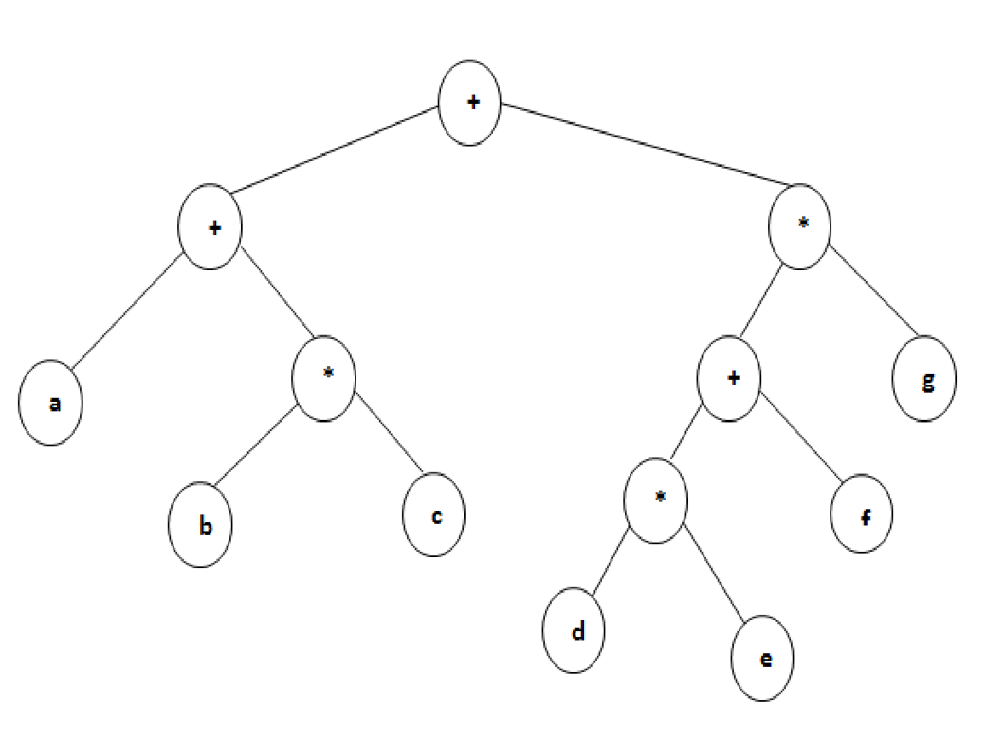

Slide 33
Binary Tree Traversal
1. Preorder traversal:-In this traversal method first process root element, then left sub tree and then right sub tree.
Procedure:-
Step 1: Visit root node
Step 2: Visit left sub tree in preorder
Step 3: Visit right sub tree in preorder

Slide 34
2. Inorder traversal:-
In this traversal method first process left element, then root element and then the right element.
Procedure:-
Step 1: Visit left sub tree in inorder
Step 2: Visit root node
Step 3: Visit right sub tree in inorder

Slide 35
3. Postorder traversal:-
In this traversal first visit / process left sub tree, then right sub tree and then the root element.
Procedure:-
Step 1: Visit left sub tree in postorder
Step 2: Visit right sub tree in postorder
Step 3: Visit root node

Slide 36
Arithmetic Expression Using BT
+
inorder traversal
A / B * C * D + E
infix expression
preorder traversal
+ * * / A B C D E
prefix expression
postorder traversal
A B / C * D * E +
postfix expression
level order traversal
+ * E * D / C A B
*
E
*
D
/
C
A
B

Slide 37
Inorder Traversal (recursive version)
void inorder(tree_pointer ptr)
/* inorder tree traversal */
{
if (ptr) {
inorder(ptr->left_child);
printf(“%d”, ptr->data);
indorder(ptr->right_child);
}
}
A / B * C * D + E

Slide 38
Preorder Traversal (recursive version)
void preorder(tree_pointer ptr)
/* preorder tree traversal */
{
if (ptr) {
printf(“%d”, ptr->data);
preorder(ptr->left_child);
predorder(ptr->right_child);
}
}
+ * * / A B C D E

Slide 39
Postorder Traversal (recursive version)
void postorder(tree_pointer ptr)
/* postorder tree traversal */
{
if (ptr) {
postorder(ptr->left_child);
postdorder(ptr->right_child);
printf(“%d”, ptr->data);
}
}
A B / C * D * E +

Slide 40
Iterative Inorder Traversal (using stack)
void iter_inorder(tree_pointer node)
{
int top= -1; /* initialize stack */
tree_pointer stack[MAX_STACK_SIZE];
for (;;) {
for (; node; node=node->left_child)
add(&top, node);/* add to stack */
node= delete(&top);
/* delete from stack */
if (!node) break; /* empty stack */
printf(“%D”, node->data);
node = node->right_child;
}
}
O(n)

Slide 41
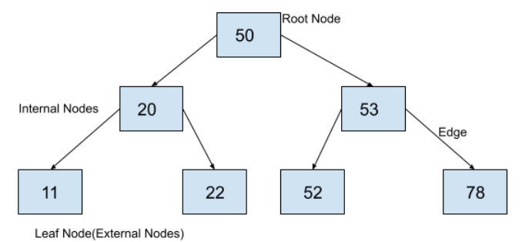
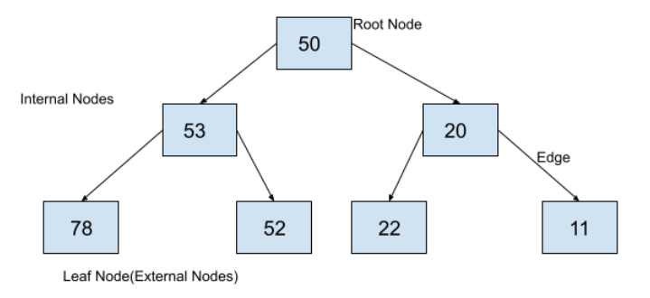
Mirror Image
Mirror image of a binary tree is another binary tree which can be created by swapping left child and right child at each node of a tree. So, to find the mirror image of a binary tree, we just have to swap the left child and right child of each node in the binary tree.

Slide 42
Mirror Image
Write a struct node.
Create the binary tree with dummy data.
Write a recursive function to find the mirror of the given binary tree.
Recursively call the function with left and right nodes.
Swap the left node data with the right node data.
Print the tree.

Slide 43
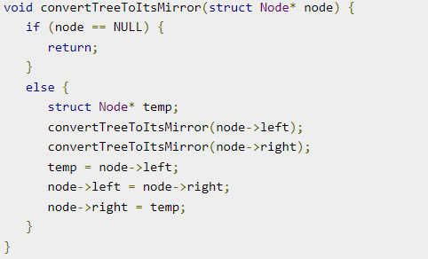
Mirror Image

Slide 44
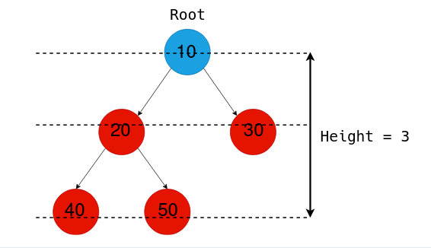
Height
The height of a Binary Tree is defined as the maximum depth of any leaf node from the root node. That is, it is the length of the longest path from the root node to any leaf node.

Slide 45
Finding Height of Binary Tree
// Find height of a tree, defined by the root node
int tree_height (Node* root) {
if (root == NULL)
return 0;
else {
// Find the height of left, right subtrees
left_height = tree_height(root->left);
right_height = tree_height(root->right);
// Find max(subtree_height) + 1 to get the height of the tree
return max(left_height, right_height) + 1;
}

